Slide 1
Dare to Dream: Get Educated!
“Create the Dream” 1st Annual Reception
College of DuPage
October 30, 2012

Slide 2
Welcome!
Bienvenido!

Slide 3
Our Mission
Dare to Dream: Get Educated! works with middle school and high school Latinas to encourage and support their efforts to graduate from high school, to encourage college enrollment, and to introduce them to college and career role models.

Slide 4
Dare to Dream: Get Educated!
Conference Participant

Slide 5
Percent of Hispanic or Latino
origin persons in the United States
in 2010 – 16.3%

Slide 6
Seeing the possibilities of a non-traditional career

Slide 7
Percent of Hispanic or Latino
origin persons in Illinois
in 2011 – 16.2%

Slide 8
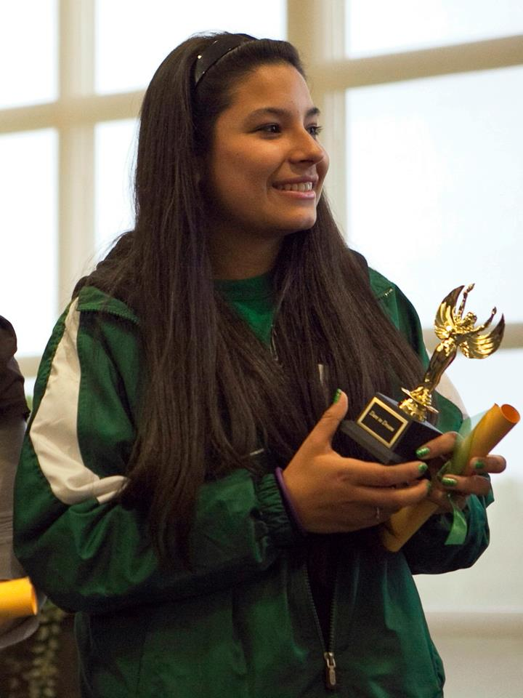
"... thank you for putting together such a wonderful conference for the Latina girls of the DuPage area. I know that the women of AAUW worked very hard to put this together and in turn, the conference was a success! I couldn’t believe the genuine interest, energy, and support that was radiating throughout the day."

Slide 9
Percent of Hispanic or Latino
origin persons in DuPage County
in 2011 – 13.6%

Slide 10
Helping Latinas find resources to help formulate their educational plans

Slide 11
In DuPage County,
Hispanic girls drop out of High School
at a rate
more than four times higher
than that of non-Hispanic white peers

Slide 12
Working together to share creativity,
provide support and make lasting friendships

Slide 13
Why is the Dare to Dream Conference
so important?
High absentee rate for middle school Latinas
High drop out rate in high school
In DuPage County, Hispanic girls drop out at a rate more than four times higher than that of
non-Hispanic white peers
Low college enrollment for Latinas

Slide 14
At Elmhurst College

Slide 15
Dare to Dream: Get Educated! Inspires Latinas with …
The dream to succeed…
The hope of a bright future…
The knowledge to craft a plan…
The dedication to pursue an education…
The desire to have a professional career…
The encouragement of a supportive community…

Slide 16
My Mother, My Mentor

Slide 17
Mothers find support on important topics such as:
American education system
Financial aid resources
Health and wellness
Immigration issues
Mentoring organizations

Slide 18
Taking the journey together … Learning together …
Supporting each other

Slide 19
THANK YOU TO OUR GENEROUS 2012 SPONSORS
AAUW
AAUW-Illinois, Inc.
AAUW branches:
Downers Grove
Elmhurst
Lombard Area
Wheaton-Glen Ellyn
College of DuPage
The DuPage Community Foundation
The DuPage Regional Office of Education
Elmhurst College
DuPage School Districts
Cindy Grau
Itasca Bank and Trust Co.
Jordan Daily Money Management
Montenegro Paper Ltd.
Office Depot
Olsen Illustrations Inc.
P & G Company
RGL Marketing for the Arts, Inc.
Pat Walton
And other local businesses

Slide 20
THANK YOU TO OUR PLATINUM SPONSORS
Anonymous
Elmhurst College

Slide 21
THANK YOU TO OUR 2012 GOLD SPONSORS
Cindy Grau
Office Depot

Slide 22
THANK YOU TO OUR 2012 SILVER SPONSORS
Montenegro Paper Ltd.
P & G Company

Slide 23
THANK YOU TO OUR 2012 BRONZE SPONSORS
College of DuPage
Itasca Bank & Trust Co.
Patricia Walton
Lombard School District #44

Slide 24
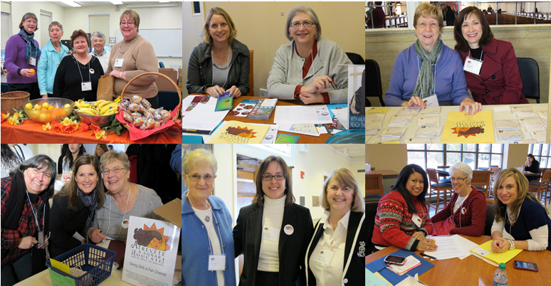
THANK YOU TO ALL OF OUR VOLUNTEERS

Slide 25
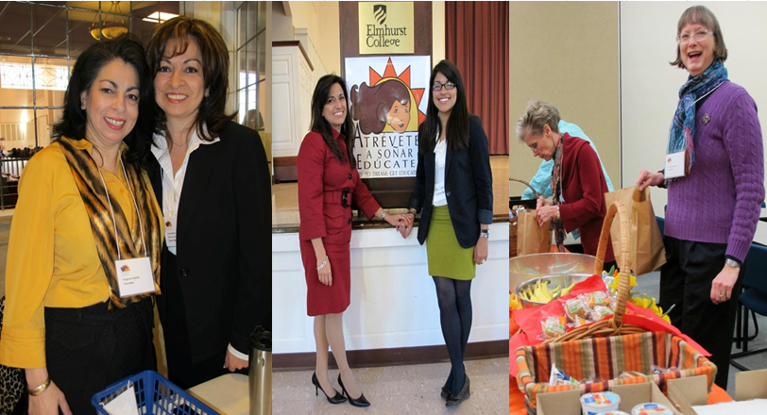
THANK YOU TO ALL OF OUR VOLUNTEERS

Slide 26
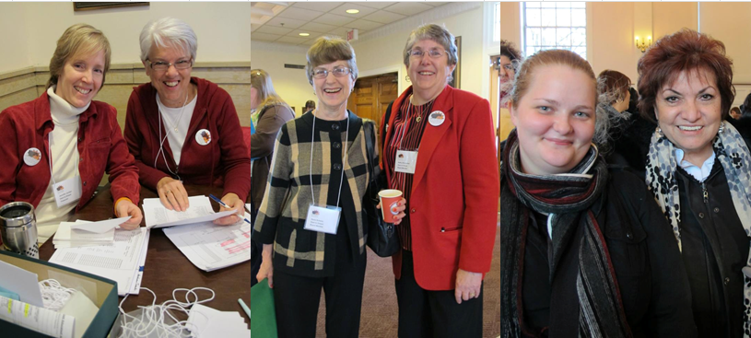
THANK YOU TO ALL OF OUR VOLUNTEERS

Slide 27
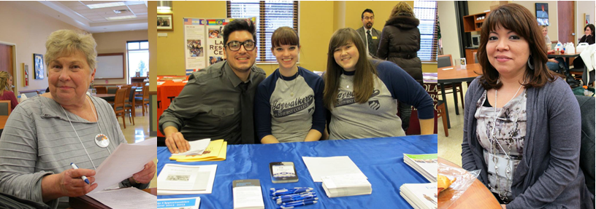
THANK YOU TO ALL OF OUR VOLUNTEERS

Slide 28
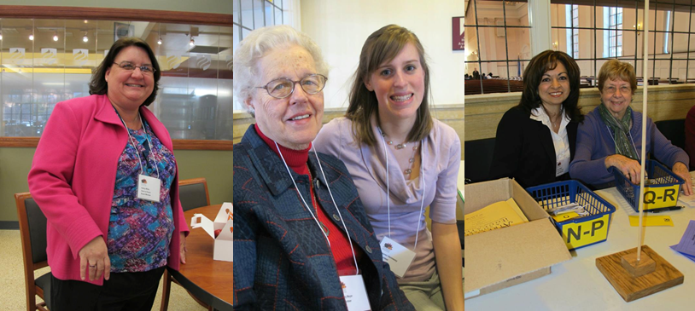
THANK YOU TO ALL OF OUR VOLUNTEERS

Slide 29
THANK YOU TO ALL OF OUR VOLUNTEERS
WHO ARE NOT PICTURED!
WHO ARE HERE TONIGHT!

Slide 30
THANK YOU TO ALL OF OUR SPEAKERS

Slide 31
THANK YOU TO ALL OF OUR SPEAKERS

Slide 32
THANK YOU TO ALL OF OUR SPEAKERS

Slide 33
THANK YOU TO ALL OF OUR SPEAKERS

Slide 34
THANK YOU TO ALL OF OUR SPEAKERS
WHO ARE NOT PICTURED!
WHO ARE HERE TONIGHT!

Slide 35
Be inspired to help us:
Dare to Dream
Create the Dream
Plan the Dream
Realize the Dream
Live The Dream

